Slide 1
I forget what I titled this

Slide 2
Fish Restoration Program

Slide 3

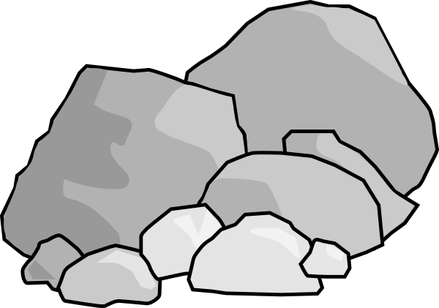
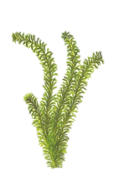
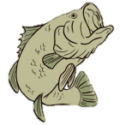

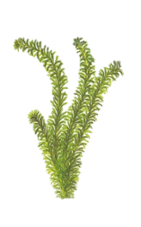




Channel
Nutrients
Production
MHHW
MLLW
Intertidal
Shallow subtidal
Deep subtidal
Notes:
We hope that restored wetlands will provide increase in habitat area and increased productivity that can be exported to channel habitat.
But these are hypotheses, how can we be sure it will work?

Slide 4

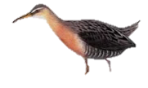
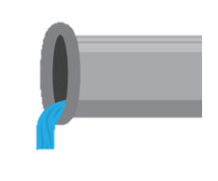
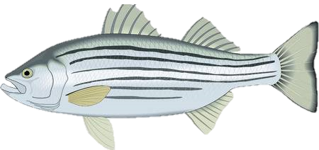

Diked wetland
Production
Seasonal release
Good bass fishing
Flooded ponds
Outside channel
Notes:
We hope that restored wetlands will provide increase in habitat area and increased productivity that can be exported to channel habitat.
But these are hypotheses, how can we be sure it will work?

Slide 5
Tidal wetland
Nutrients
Intertidal channel
Mud flat
Production
MHHW
MLLW
Intertidal
Shallow subtidal
Deep subtidal
Notes:
We hope that restored wetlands will provide increase in habitat area and increased productivity that can be exported to channel habitat.
But these are hypotheses, how can we be sure it will work?

Slide 6
Muted Tidal wetland
Nutrients
Production
MHHW
MLLW
Intertidal
Shallow subtidal
Deep subtidal
Notes:
We hope that restored wetlands will provide increase in habitat area and increased productivity that can be exported to channel habitat.
But these are hypotheses, how can we be sure it will work?

Slide 7
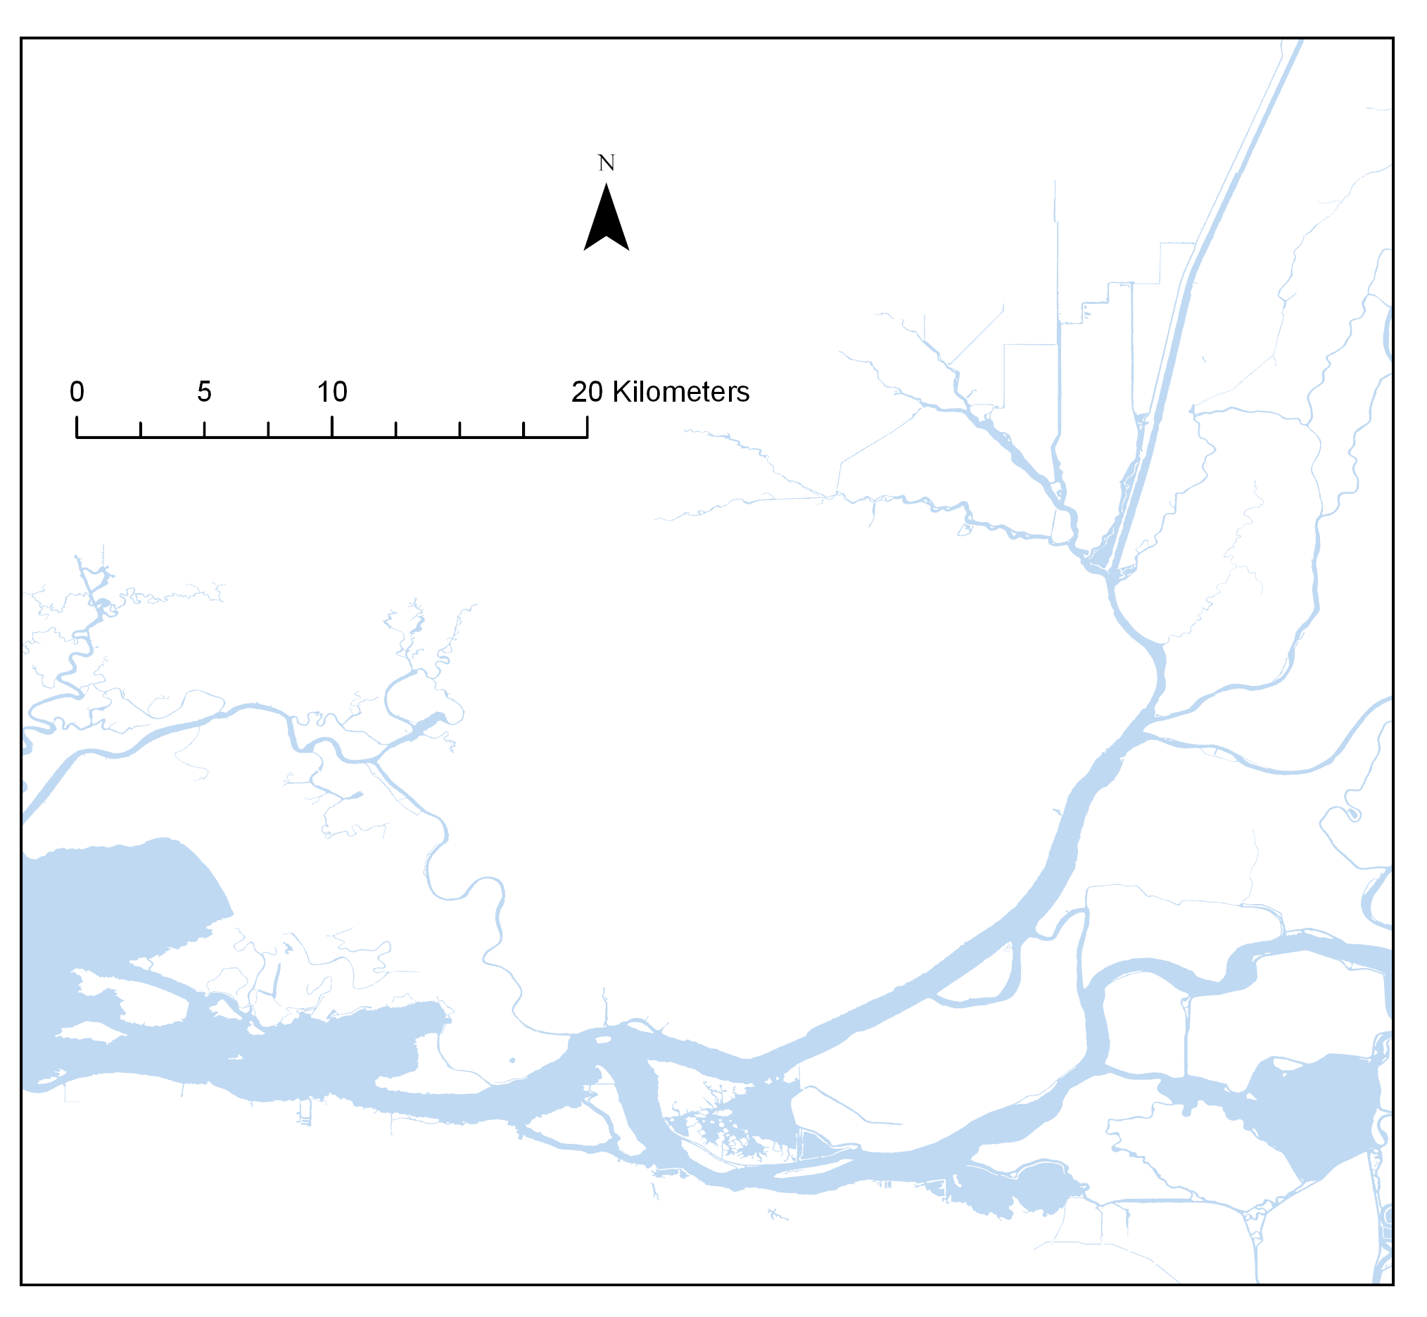
Cache Slough
Suisun Marsh
Grizzly
Sac-San Joaquin
Confluence

Slide 8
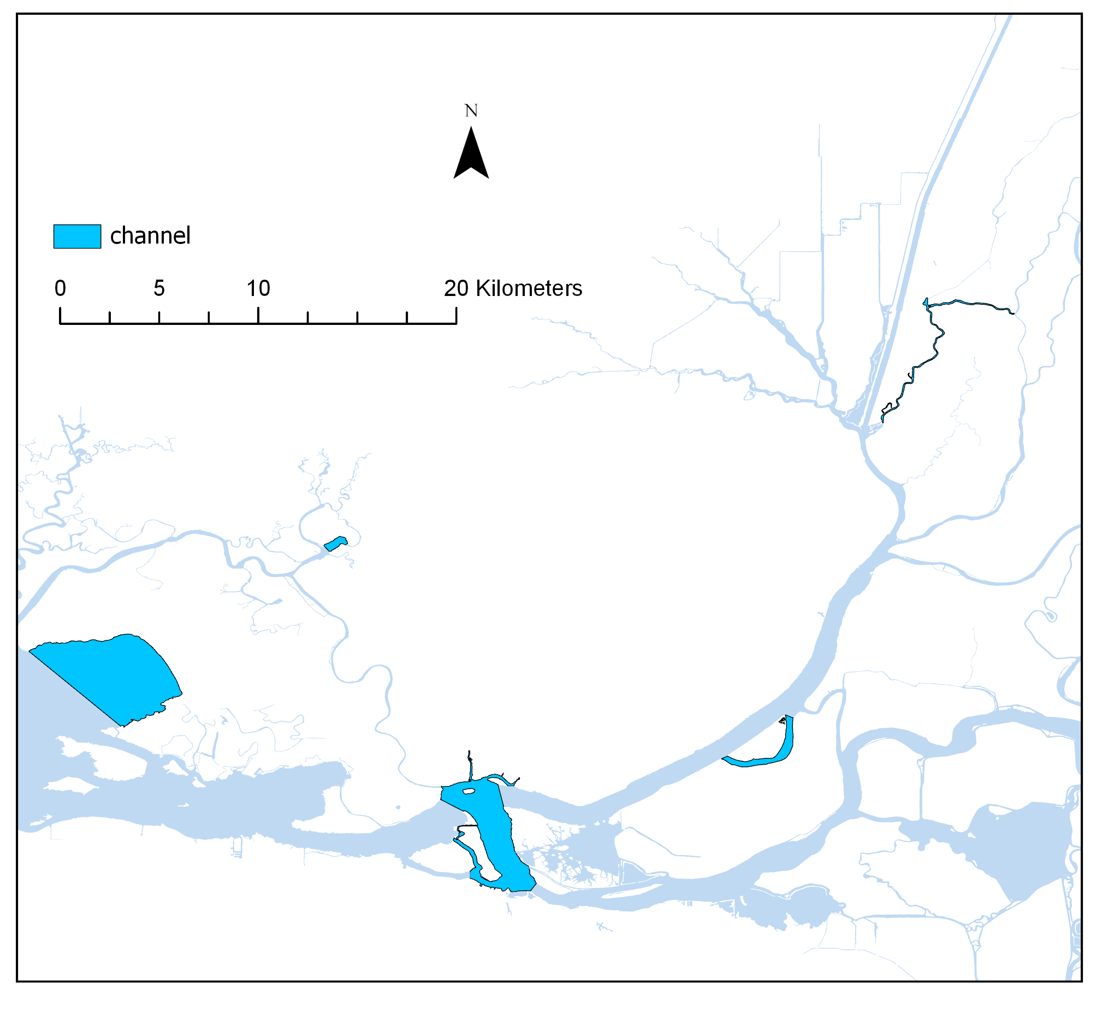
Cache Slough
Miner Slough
Suisun Marsh
Little Honker Bay
Grizzly
Sac-San Joaquin
Grizzly Bay
Confluence
Horseshoe Bend
Broad Slough

Slide 9
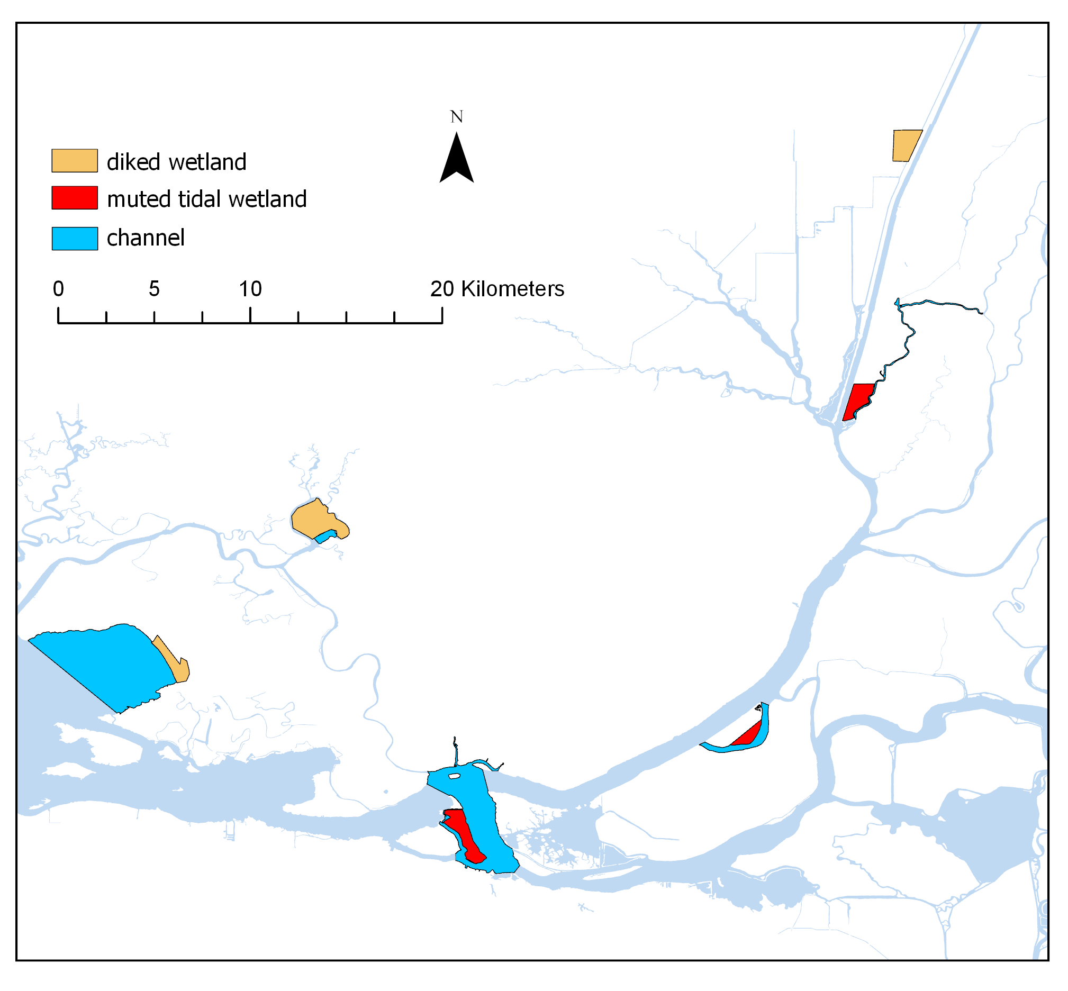
Flyway
Farms
Cache Slough
Miner Slough
Suisun Marsh
Prospect
Island
Bradmoor
Little Honker Bay
Grizzly
Tule Red
Sac-San Joaquin
Grizzly Bay
Confluence
Decker
Island
Horseshoe Bend
Winter
Island
Broad Slough

Slide 10
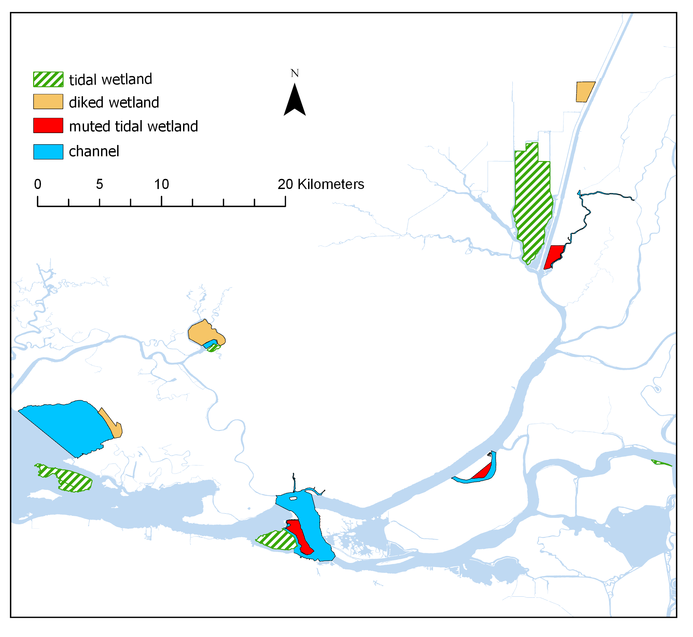
Flyway
Farms
Cache Slough
Liberty
Island
Miner Slough
Suisun Marsh
Prospect
Island
Bradmoor
Little Honker Bay
Grizzly
Blacklock
Tule Red
Sac-San Joaquin
Grizzly Bay
Confluence
Decker
Island
Stacy’s
Island
Ryer
Island
Horseshoe Bend
Winter
Island
Broad Slough
Browns
Island

Slide 11

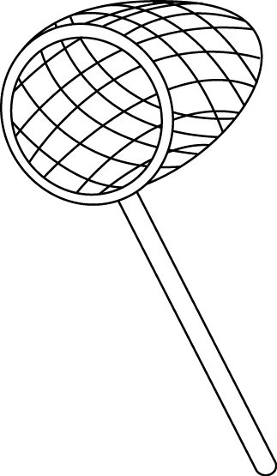

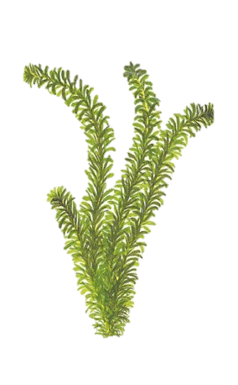


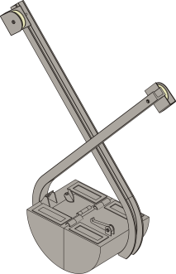
Sampling Methods
open-water or
tidal channel
vegetated habitat
SAV
FAV
EAV
Chl-a
Neuston tow
Zooplankton/Mysid tow
Phytoplankton grab
Chlorophyll
Ponar grab
Sweep net
PVC core

Slide 12
Analysis
ANOVAs or GLMMs for total bug abundance
PerMANOVA and NMDS for community composition
Multipattern analysis to find indicator species?
Length distribution?
Biomass calculation?

Slide 13
Question: Volumes
Mysids = flowmeter
Neuston = surface area x 50% of mouth area?
Sweep nets = mouth area x 5?
It’s rough, but maybe useful for comparison?

Slide 14
What should I do about the unbalanced design? Couldn’t get good mysid tows in diked wetlands.

Slide 15
GLMM
Log(CPUE+1) ~ Gear + sitetype + Error(Site)
 | Estimate | Std. Error | df | t value | Pr(>|t|)
(Intercept: mysid, channel) | 1.168 | 0.2271 | 14.435 | 5.143 | 0.000136 | ***
Gear:Neuston | -0.5849 | 0.1804 | 408.695 | -3.242 | 0.001285 | **
Gear: Vegetation | 2.6769 | 0.1666 | 413.532 | 16.070 | < 2e-16 | ***
Diked wetland | 1.1111 | 0.4138 | 19.488 | 2.685 | 0.01444 | *
Muted tidal wetland | 0.9411 | 0.3391 | 10.1559 | 2.775 | 0.019336 | *
Tidal wetland | 0.6477 | 0.2903 | 11.329 | 2.231 | 0.046771 | *
Post-hoc shows wetland sites have higher catch overall from channel sites, but wetlands are not different from each other.
Earlier analyses with AIC did not support use of Year or Region as predictor variables

Slide 16
c
a
b
b
b
b
a

Slide 17
Multivariates

Slide 18
Multivariates

Slide 19
Multivariates
Permanova
 | Df | SumsOfSqs | MeanSqs | F.Model | R2 | Pr(>F)
Region | 4 | 6.332 | 1.583 | 11.016 | 0.073 | 0.001 | ***
SiteType | 3 | 7.928 | 2.643 | 18.390 | 0.092 | 0.001 | ***
Habitat | 2 | 6.713 | 3.356 | 23.356 | 0.078 | 0.001 | ***
site | 9 | 7.005 | 0.778 | 5.416 | 0.081 | 0.001 | ***
Residuals | 406 | 58.343 | 0.144 |  | 0.676
Total | 424 | 86.32 |  |  | 1

Slide 20
Indicator species
Diked Wetlands
 | stat | p.value
Dytiscidae | 0.416 | 0.001 | ***
Eogammarus | 0.384 | 0.001 | ***
Mosquitofish | 0.297 | 0.001 | ***
Gammarid | 0.263 | 0.001 | ***
Corixidae | 0.252 | 0.002 | **
Prickly Sculpin | 0.237 | 0.002 | **
Threespine Stickleback | 0.235 | 0.002 | **
Americorophium spinicorne | 0.232 | 0.001 | ***
Hydrophilidae | 0.228 | 0.002 | **
Fish larvae | 0.227 | 0.001 | ***
Chorophiid | 0.19 | 0.001 | ***
Hydrobiidae | 0.169 | 0.001 | ***
Hydroscaphidae | 0.162 | 0.009 | **
Crayfish | 0.154 | 0.047 | *
Notonectidae | 0.153 | 0.027 | *
Americorophium stimpsoni | 0.145 | 0.046 | *
Channel
 | stat | p.value
Thrips | 0.151 | 0.037 | *
Muted Tidal Wetlands
 | stat | p.value
Mesoveliidae | 0.255 | 0.001 | ***
Palaemonetes | 0.176 | 0.01 | *
Crangonyx | 0.17 | 0.013 | *
Hemiptera Other | 0.151 | 0.024 | *
Tipulidae | 0.141 | 0.026 | *
Vellidae | 0.131 | 0.028 | *
Tidal Wetlands
 | stat | p.value
Gnorimosphaeroma | 0.202 | 0.005 | **
Snail Other | 0.168 | 0.015 | *
Notes:
This function studies the association between species patterns and combinations of groups of sites.
Use the “multipatt” function for multiple pattern analysis in the indicspecies package.
Some of these critters are pretty rare, I’d like to lump some of them into “other” and re-runthe analysis.

Slide 21
Indicator Groups
Channel
 | stat | p.value
Thrips | 0.151 | 0.037 | *
Tidal Wetlands
 | stat | p.value
Isopoda | 0.201 | 0.004 | **
Diked Wetlands
 | stat | p.value
Gammaridae | 0.3 | 0.001 | ***
Hemiptera | 0.24 | 0.001 | ***
fish | 0.232 | 0.001 | ***
Amphipoda | 0.214 | 0.001 | ***
Lepidoptera | 0.137 | 0.04 | *
Muted Tidal Wetlands
 | stat | p.value
Decapoda | 0.174 | 0.011 | *
Diptera | 0.147 | 0.034 | *

Slide 22
Clams
Since we changed the way we processed benthic samples this year, I’m planning on a separate analysis just of invasive clams

Slide 23
 | Estimate | Std. Error | df | t value | Pr(>|t|)
(Intercept) | 6.0466 | 1.9186 | 14.5212 | 3.152 | 0.00681
sitetypediked | -4.5199 | 1.5872 | 6.7184 | -2.848 | 0.02588
sitetypemuted | -2.0581 | 1.4245 | 4.4161 | -1.445 | 0.21552
sitetypetidal | -0.9151 | 1.3042 | 5.2824 | -0.702 | 0.51256
Region2Confluence | -0.7101 | 1.8662 | 13.336 | -0.381 | 0.70955
Region2Grizzly | -1.5576 | 1.8774 | 13.5309 | -0.83 | 0.42113
Region2NurseDenverton | -1.42 | 2.2402 | 13.0383 | -0.634 | 0.53713
Region2SacSanJ | -0.399 | 1.916 | 13.9592 | -0.208 | 0.83803
Year22018 | 0.1895 | 0.8366 | 44.4687 | 0.227 | 0.82184

Slide 24
Pairwise comparisons
For IEP, keep it broad, don’t get into these too much, but include them in the resport.

Slide 25
Winter versus Browns Versus Broad

Slide 26
Total catch GLM
b
NS
b
a
 | Df | Sum Sq | Mean Sq | F value | Pr(>F)
site | 2 | 79.97 | 39.99 | 19.776 | <0.0001 | ***
Gear type | 2 | 186.78 | 93.39 | 46.189 | <0.0001 | ***
Year | 1 | 0.06 | 0.06 | 0.031 | 0.86
Residuals | 103 | 208.26 | 2.02
b
a
a

Slide 27
Multivariates

Slide 28
Multivariates
PERMANOVA | Df | SumsOfSqs | MeanSqs | F.Model | R2 | Pr(>F)
site | 3 | 3.643 | 1.214 | 9.228 | 0.221 | 0.001 | ***
Year | 1 | 0.454 | 0.454 | 3.449 | 0.028 | 0.019 | *
targets2 | 2 | 2.125 | 1.063 | 8.076 | 0.129 | 0.001 | ***
Residuals | 78 | 10.265 | 0.132 |  | 0.623
Total | 84 | 16.488 |  |  | 1

Slide 29
Miner versus Prospect Versus Liberty versus Flyway
Notes:
Should I break flyway out by itself?
Need to add IEP samples.

Slide 30
Lenghts and/or Biomass
Ways to extrapolate lengths to plus-counted critters:
Don’t extrapolate lengths, just compare distributions of critters you measured
Use the mean length of all the measured critters and assign it to all the plus-counted critters.
Use the median length of all the measured critters and assign it to all the plus-counted critters.
Calculate frequency of each length in the counted critters and extrapolate it to the whole set.
Calculate the mean and standard deviation of all the counted critters and assign a random length drawn from a normal distribution with that mean and SD to each of the plus-counted critters (that one is probably overkill).

Slide 31
Figure X. density curves of length-frequency distributions of amphipods in the blitz samples. Length is in microns. Note the greater number of large amphipods in the diked wetland samples.

Slide 32
Histogram of length-frequency distributions of amphipods in the blitz samples. Length is in microns. Note the greater number of large amphipods in the diked wetland samples. (Free Y axis)

Slide 33
Histogram of length-frequency distributions of amphipods in the blitz samples. Length is in microns. Note the greater number of large amphipods in the diked wetland samples. (Free Y axis)

Slide 34
Histogram of length-frequency distributions of amphipods in the blitz samples. Length is in microns. Note the greater number of large amphipods in the diked wetland samples. (Fixed Y axis)

